Slide 1
Metro Technical Advisory Committee
Settlement Offer R9-2022-0148
(Violations of Order R9-2017-0007)
November 16, 2022
Public Utilities Department

Slide 2

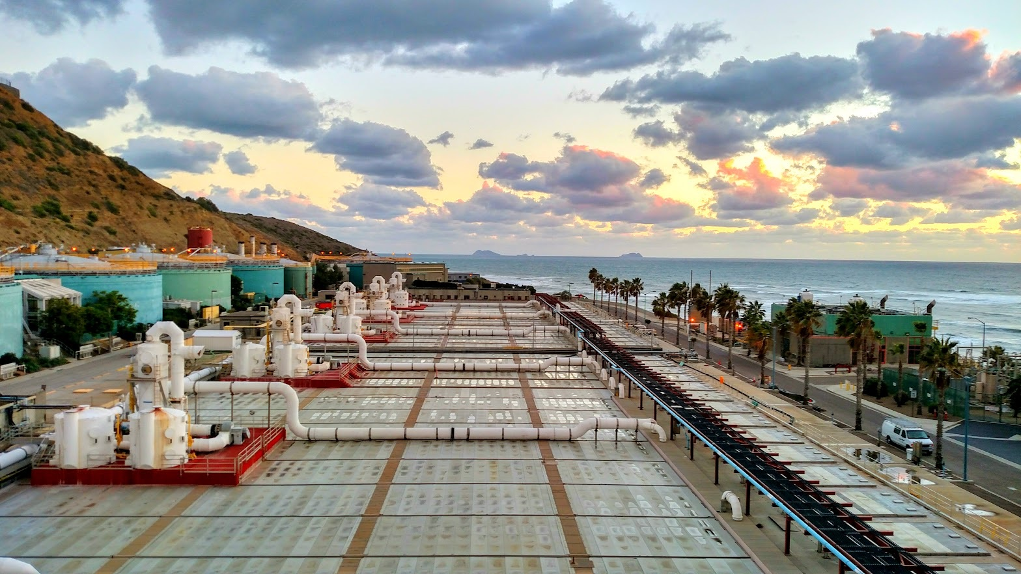
Public Utilities
Issue – Violations of Order R9-2017-0007
Violations (Mar-June 2022)
Turbidity
TSS (PLWTP)
TSS (system)
Oil & Grease
Suspended Solids

Slide 3
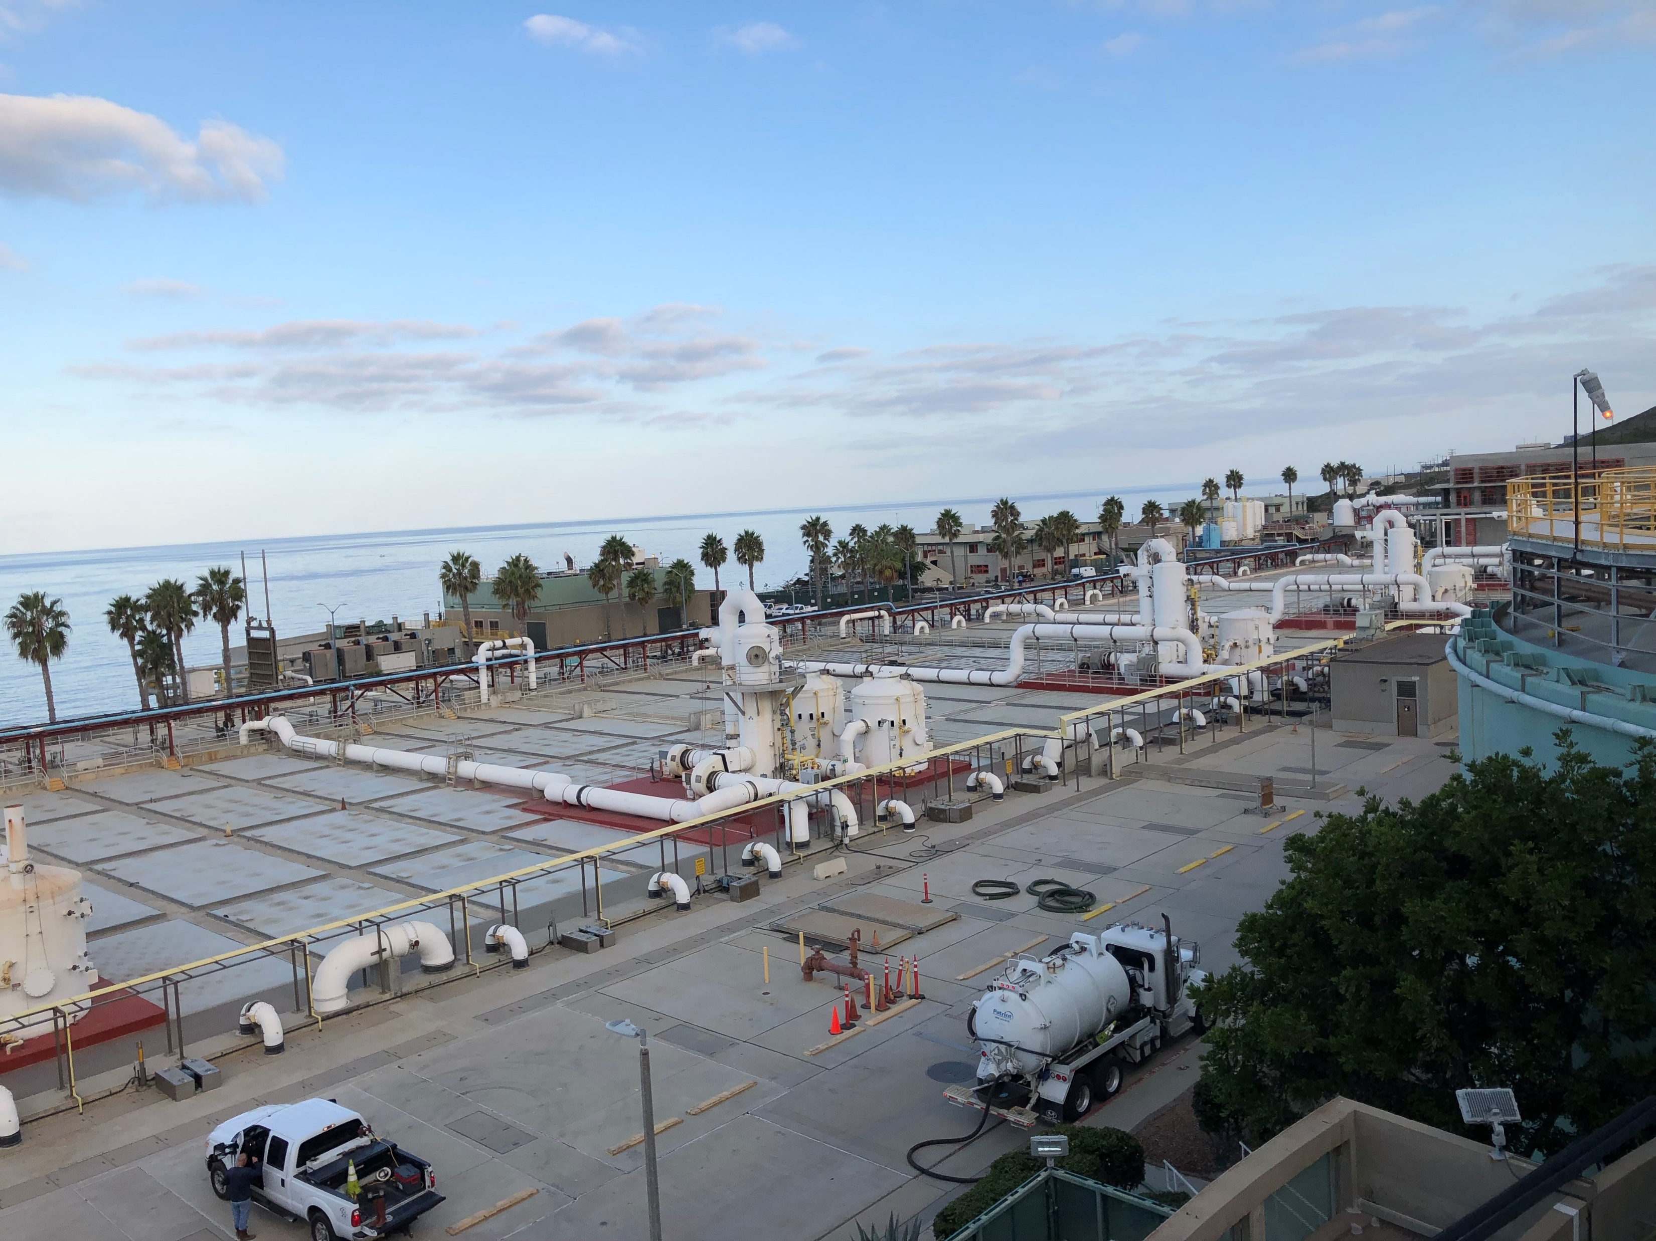
Public Utilities
Waste Discharge Requirements, Order R9-2017-0007
Requirements
Turbidity (<75 NTU, <100 NTU)
TSS (PLWTP) (>75%, 60 mg/l)
TSS (system) (>80%)
Oil & Grease (25 mg/l)
Suspended Solids (3 ml/L, inst.)

Slide 4
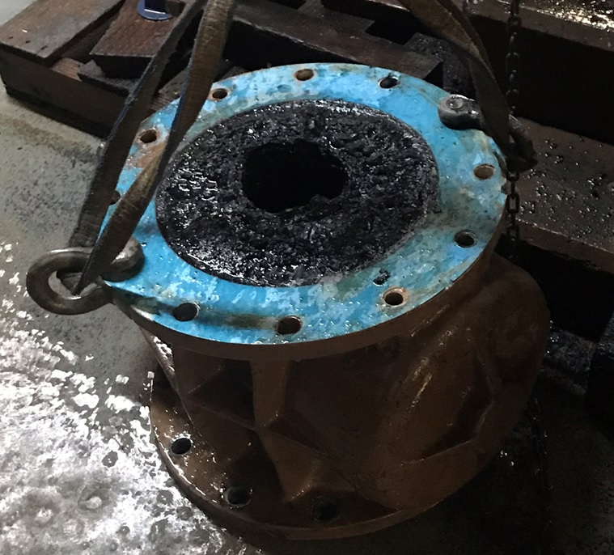
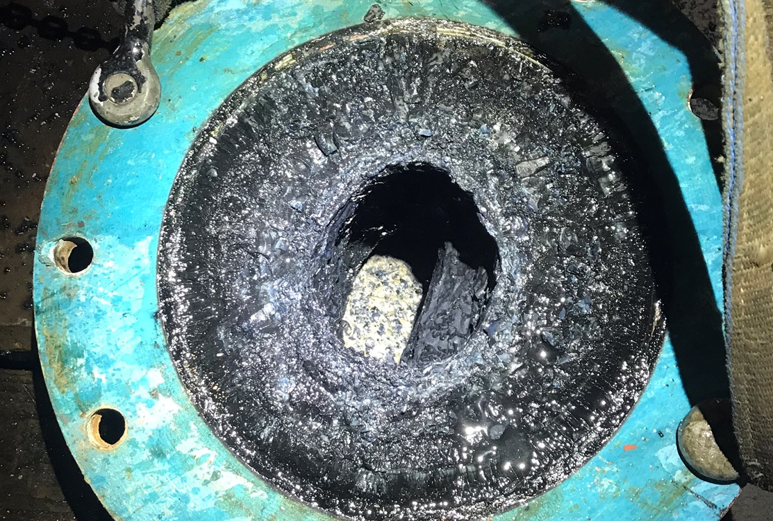
Public Utilities
Root causes
Dewatering line break
(removes solids from sed tanks)
Pure Water Construction
(higher, older solids)
Vivianite
(scale, crystal formation plus lapse in contract)

Slide 5
Public Utilities
Settlement Agreement
ACL mandatory minimum penalty (3 serious, 15 non-serious violations)
MMP = $54,000
Supplemental Environmental Project/SCCWRP = $34,000
State Water Pollution Abatement Account = $19,500
Treatment process normalized since July 1st

Slide 6

Questions?
Notes:
Looking forward, there are plenty of opportunities/reasons for the two Divisions to interface/interact/communication/share information, perhaps train together etc.

